Slide 1
Abstract Classes & Interfaces
BACS2023 Object-Oriented Programming
Chapter 7 – Part 1

Slide 2
Learning Outcomes
At the end of this lesson, you should be able to
Design and use abstract classes.
Describe the difference between abstract classes and concrete classes
Explain the rationale for creating abstract classes
Define custom interfaces and declare classes that implement interfaces.
Specify behavior for objects using interfaces
  Define a natural order using the Comparable interface.

Slide 3
1. Introduction
In the inheritance hierarchy,
  classes become more specific and concrete with each new subclass.
  classes become more general (i.e. less specific) if you move up the class hierarchy.
Class design should ensure that a superclass contains common features of its subclasses.
Sometimes a superclass is so abstract that it cannot have any specific instances. Such a class referred to as an abstract class.
GeometricObject
Circle
Rectangle
Notes:
CollegeCommunity //Concrete Class
Student Staff //Concrete Classes
CertificateStudent DiplomaStudent AdvancedDiplomaStudent AcademicStaff GeneralStaff AdminStaff //Concrete Classes
----------------------------------------------------------------------------------------------------------------------------------------
GeometricObject //Abstract Class
Circle Rectangle //Concrete Classes
Ball Planet MoonCake Table Whiteboard Paper //Concrete Classes
/*multiple inheritance*/ /*multiple inheritance*/

Slide 4
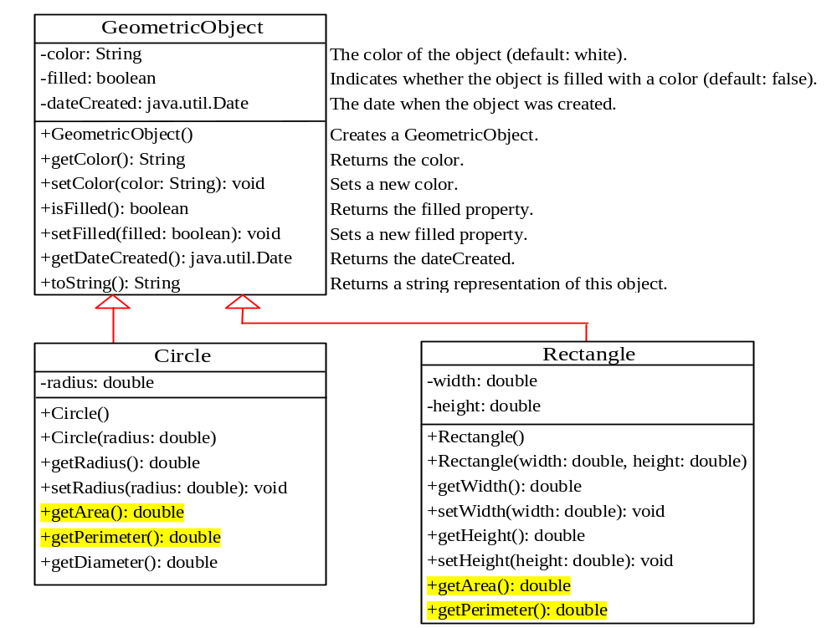
GeometricObject, Circle and Rectangle classes from Chapter 6 (1)

Slide 5
GeometricObject, Circle and Rectangle classes from Chapter 6 (2)
GeometricObject is the superclass for Circle and Rectangle.
  It models common features of geometric objects.
Circle and Rectangle contains the getArea() and getPerimeter() methods.
  Since you can compute areas and perimeters for all geometric objects, it is better to declare the getArea() and getPerimeter()methods in the GeometricObject class.
  However, these methods cannot be implemented in the GeometricObject class because their implementation depends on the specific type of geometric object.
    Such methods are referred to as abstract methods.
    Abstract methods can only exist within abstract classes.

Slide 6
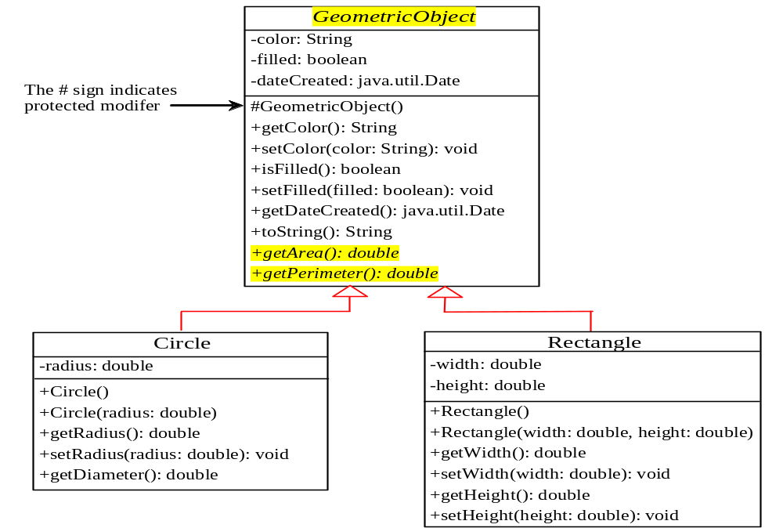
2.GeometricObject as an Abstract Class (1)
In the UML class diagram, the names of abstract classes and abstract methods are italicized.
Cannot be implmented
Notes:
You can compute areas and perimeters for all geometric objects, it its better to declare the getArea() and getPerimeter() methods in the GeometricObject class.
But, getArea() and getPerimeter() methods cannot be implemented in the GeometricObject class because their implementation is dependent on the specific type of geometric object.
Therefore, getArea() and getPerimeter() methods are referred to as abstract methods (no implementation).
After you declare the abstract methods in GeometricObject class, GeometricObject class becomes an abstract class.
➔ A class that contains abstract methods must be declared abstract.

Slide 7
GeometricObject as an Abstract Class (2)
The GeometricObject abstract class provides the common features (data and methods) for geometric objects.
The constructor in the abstract class is declared protected because it is used only by its subclasses.
public abstract class GeometricObject {
private String color = "white";
private boolean filled;
private java.util.Date dateCreated;
protected GeometricObject() {
dateCreated = new java.util.Date();
}
public String getColor() {
return color;
}
……..
}

Slide 8
GeometricObject as an Abstract Class (3)
As geometric object is too general and we do not know how to compute the area and perimeter (since the formula depends on the specific type of geometric object),
  getArea() and getPerimeter() are defined as abstract methods.
public abstract class GeometricObject {
private String color = "white";
private boolean filled;
private java.util.Date dateCreated;
protected GeometricObject() {
dateCreated = new java.util.Date();
}
….
/** Abstract method getArea */
public abstract double getArea();
/** Abstract method getPerimeter */
public abstract double getPerimeter();
}

Slide 9
The abstract Modifier
The abstract class
  Cannot be instantiated
  Should be extended and implemented in subclasses
The abstract method
  Method signature without implementation
  Its implementation is provided by its subclasses
  A class that contains abstract methods must be declared abstract.

Slide 10
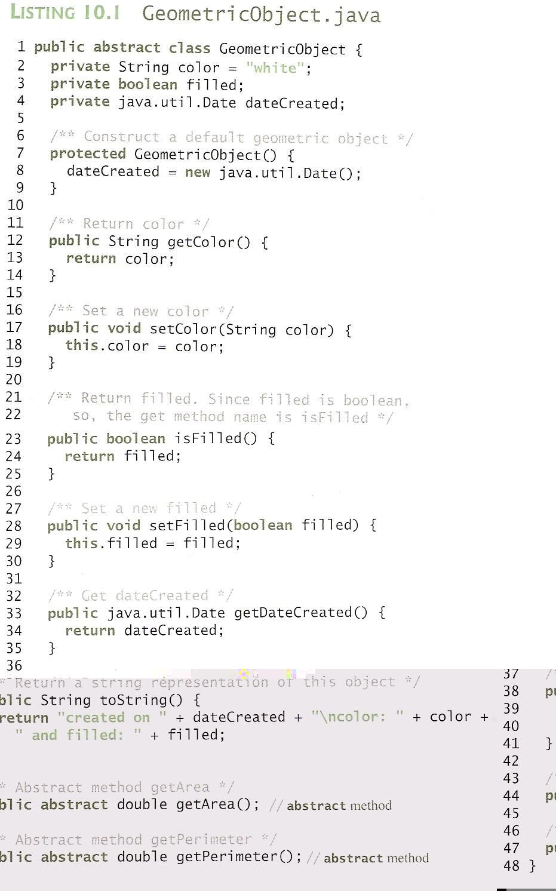
Notes:
Abstract classes are like regular classes with data and methods, but you cannot create instances of abstract classes using the new operator.
An abstract method is a method signature without implementation.
Its implementation is provided by the subclasses.

Slide 11
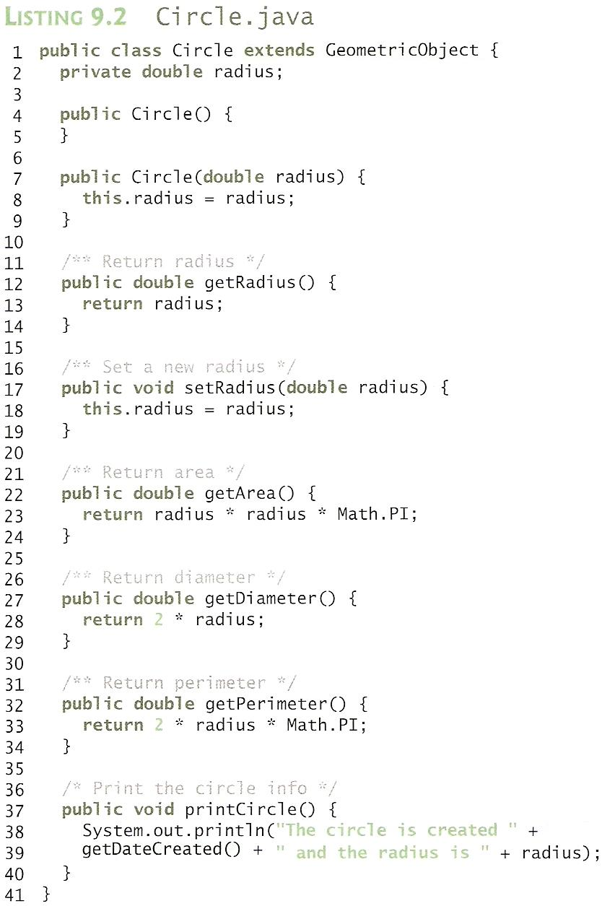
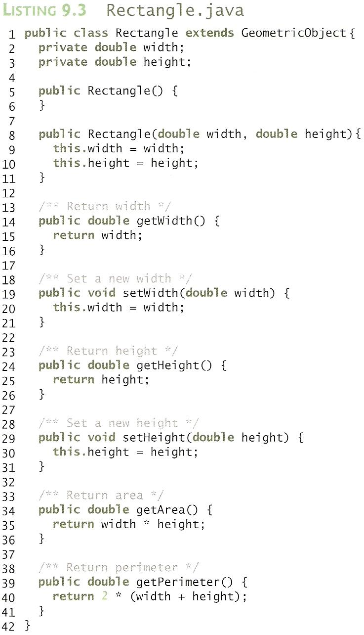
Notes:
The implementation of Circle and Rectangle is the same as in Listing 9.2 and 9.3 except that don’t have the package statement.

Slide 12
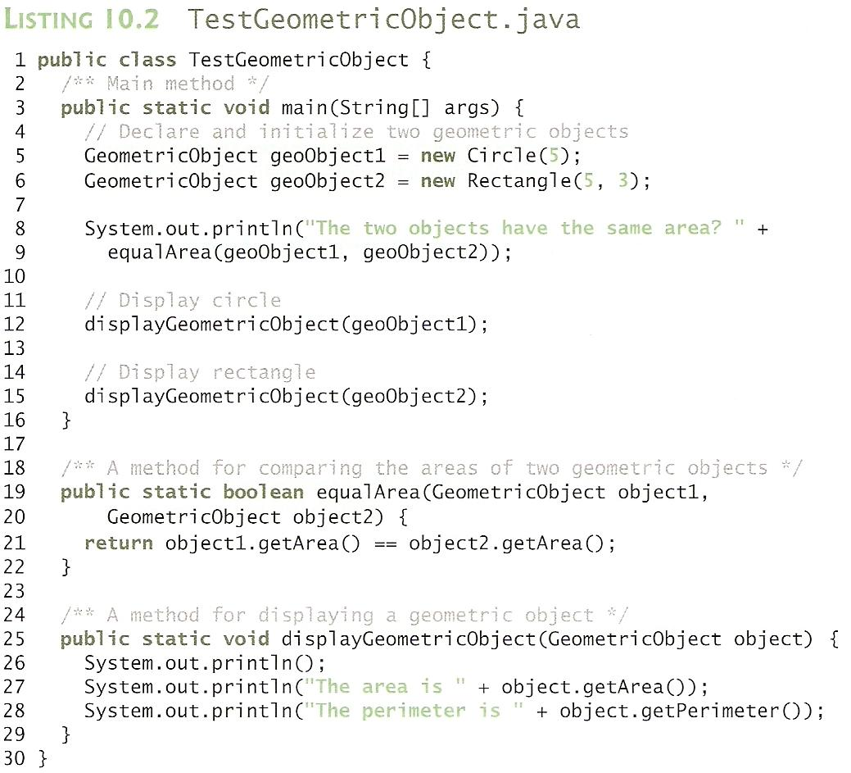
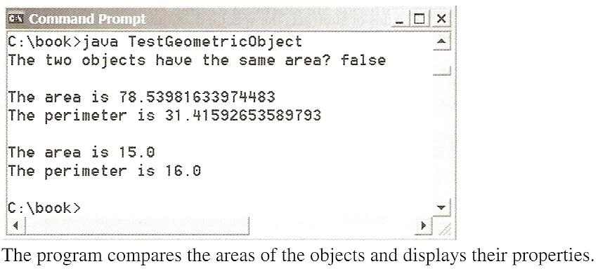
Cannot create an instance from an abstract class using the new operator,
Notes:
The methods getArea() and getPerimeter() defined in the GeometricObject class are overridden in the Circle and Rectangle class.
GeometricObject geoObject1 = new Circle(5);
GeometricObject geoObject2 = new Rectangle(5, 3);
Note:
You cannot create an instance from an abstract class using the new operator,
GeometricObject objects = new GeometricObject; // Invalid statement: an instance from an abstract class.
but an abstract class can be used as a data type.
GeometricObject[] objects = new GeometricObject[10]; // An array whose elements are of GeometricObject type.

Slide 13
3. Important Points to Note (1)
public abstract class GeometricObject {
private String color = "white";
private boolean filled;
private java.util.Date dateCreated;
protected GeometricObject()
{dateCreated = new java.util.Date(); }
public String getColor()
{ return color; }
public void setColor(String color)
{ this.color = color; }
……….
public String toString() {
………
}
/** Abstract method getArea */
public abstract double getArea();
/** Abstract method getPerimeter */
public abstract double getPerimeter();
}
An abstract method cannot be contained in a non abstract class.
An abstract class may contain no abstract methods.
A subclass of an abstract superclass must either
  Implement all its superclass’ abstract methods, or
  Be itself an abstract class.
Superclass
(abstract)
subclass1
subclass2

Slide 14
Important Points to Note (2)
An abstract class cannot be instantiated using the new operator, i.e.
  you cannot create objects of abstract classes.
  the abstract class is to be used as a base class for defining new subclasses.
However,
  Its constructors may still be defined, to be invoked in the constructors of its subclasses.
  An abstract class can be used as a data type.
A subclass can be abstract even if its superclass is concrete.
  E.g. the Object class is concrete, but its subclasses, such as GeometricObject, may be abstract.
Superclass
(abstract)
Subclass
Superclass
(concrete)
Subclass

Slide 15
4. Advantages of Defining Abstract Methods
public class TestGeometricObject {
public static void main(String[] args){
  GeometricObject g1 = new Circle(5);
  GeometricObject g2 = new Rectangle(5, 3);
  System.out.println("The two objects have
  the same area? " + equalArea(g1, g2));
  displayObject(g1);
  displayObject(g2);
}
public static boolean
equalArea(GeometricObject j1,GeometricObject j2){
return j1.getArea() == j2.getArea();
}
public static void displayObject(GeometricObject obj){
  System.out.println();
  System.out.println(“Area is " + obj.getArea());
  System.out.println(“Perimeter is " + obj.getPerimeter());
}
}
Ensures that the abstract methods are implemented
by the subclasses.
Can invoke the abstract methods on parameters of the superclass (i.e. the abstract class type)
  E.g. the equalArea() and displayObject() methods of TestGeometricObject.java.
Demo 7.1

Slide 16
5. The Calendar and GregorianCalendar Classes [Optional] - (1)
An instance of java.util.Date represents a specific instant in time with millisecond precision.
java.util.Calendar is an abstract base class for extracting detailed calendar information, such as year, month, date, hour, minute, and second.
Subclasses of Calendar can implement specific calendar systems, such as the Gregorian calendar, the lunar calendar and Jewish calendar.
Currently, java.util.GregorianCalendar for the Gregorian calendar is supported in Java.

Slide 17
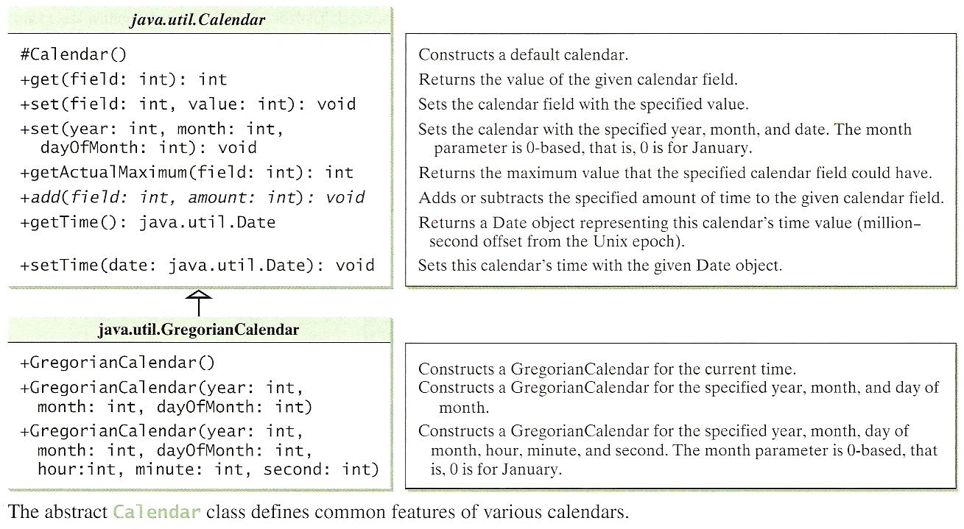
The Calendar and GregorianCalendar Classes [Optional] - (2)

Slide 18
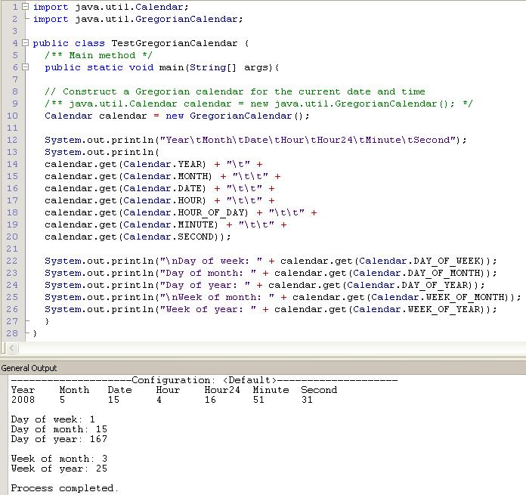
TestGregorianCalendar.java (Demo 7.2)
Demo 7.2

Slide 19
6. Interfaces
An interface is a class-like construct that contains only constants and abstract methods.
Example:
public interface Edible {
/** Describe how to eat */
public abstract String howToEat();
}

Slide 20
Interfaces
An interface is similar to an abstract class, but an abstract class can contain variables and concrete methods as well as constants and abstract methods.
Constants
Abstract Methods
Variables
Concrete Methods
Interface
Abstract Class

Slide 21
Why is an interface useful?
We can use interfaces to specify behavior for objects.
For example, you can specify that the objects are comparable, edible, cloneable using appropriate interfaces.

Slide 22
Define an Interface
To distinguish an interface from a class, Java uses the following syntax to declare an interface:
public interface InterfaceName {
constant declarations;
method signatures;
}
Example:
public interface Edible {
/** Describe how to eat */
public abstract String howToEat();
}

Slide 23
Example
You can now use the Edible interface to specify whether an object is edible.
This is accomplished by letting the class for the object implement this interface using the implements keyword.
E.g., the classes Chicken and Fruit in Listing 11.5 implement the Edible interface.
Refer to the classes in the Demo 7.3 folder.
Edible
TestEdible

Slide 24
public class TestEdible {
public static void main(String[] args) {
Object[] objects = {new Tiger(), new Chicken(), new Apple()};
for (int i = 0; i < objects.length; i++)
if (objects[i] instanceof Edible)
System.out.println(((Edible) objects[i]).howToEat());
}
}
class Animal {}
class Chicken extends Animal implements Edible {
public String howToEat()
{ return "Chicken: Fry it"; }
}
class Tiger extends Animal {}
abstract class Fruit implements Edible {}
class Apple extends Fruit {
public String howToEat()
{return "Apple: Make apple cider"; }
}
class Orange extends Fruit {
public String howToEat()
{ return "Orange: Make orange juice"; }
}
public interface Edible {
/** Describe how to eat */
public abstract String howToEat();
}

Slide 25
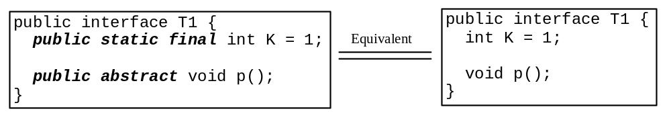
Omitting Modifiers in Interfaces
  In an interface,
    All data fields are public final static and
    all methods are public abstract .
  For this reason, these modifiers can be omitted, as shown below:
  A constant defined in an interface can be accessed using syntax InterfaceName.CONSTANT_NAME (e.g., T1.K).

Slide 26
7. The Comparable Interface
// This interface is defined in
// java.lang package
package java.lang;
public interface Comparable {
public int compareTo(Object o);
}
Many classes (e.g., String and Date) in the Java library implement Comparable to define a natural order for the objects.

Slide 27
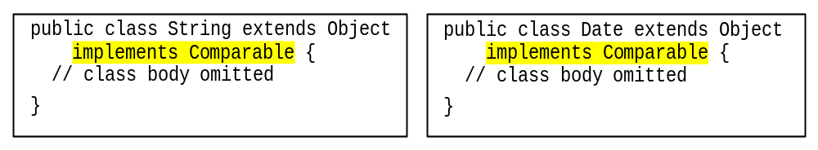
The Comparable Interface
Many classes (e.g., String and Date) in the Java library implement Comparable to define a natural order for the objects.

Slide 28
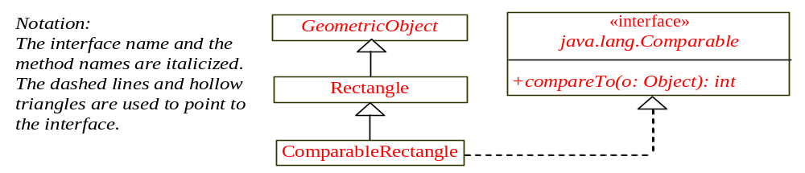
Declaring Classes to Implement Comparable
Say we want to be able to compare 2 rectangles (eg area), we can declare a new rectangle class that implements Comparable. The instances of this new class are comparable. UML Notation: The interface name and method names are italized. Dashed lines and hollow triangle is used to point to the interface.

Slide 29
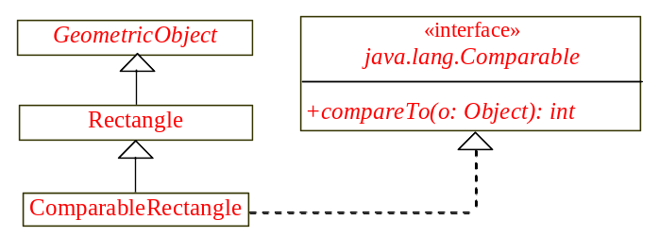

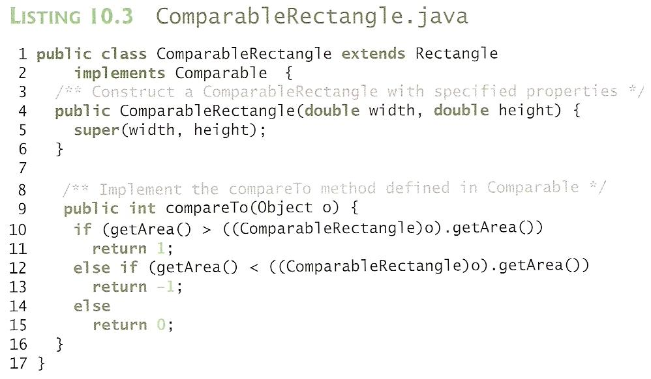
ComparableRectangle
Demo 7.5
Notes:
You can now use the max method to find the larger of two objects of ComparableRectangle.
Here is an example:
ComparableRectangle rectangle1 = new ComparableRectangle(4,5);
ComparableRectangle rectangle2 = new ComparableRectangle(3,6);
System.out.println(Max.max(rectangle1, rectangle2));
System.out.println(“\nRectangle1 Compare To Rectangle2\n--------------------------------");
System.out.println(rectangle1.compareTo(rectangle2));

Slide 30
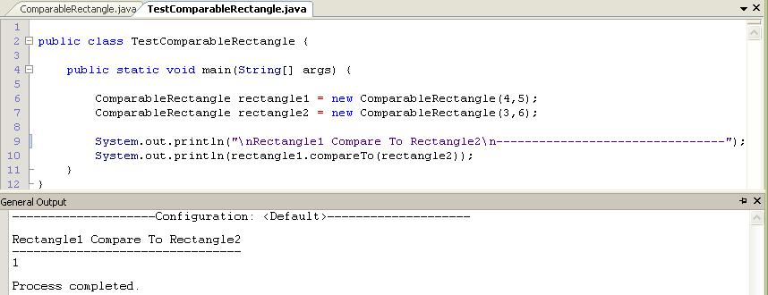
TestComparableRectangle
Version1
Version2
Notes:
System.out.println(Max.max(rectangle1, rectangle2));
Output:
created on Fri Jul 25 18:33:18 SGT 2008
color: white and filled: false

Slide 31
To Do
Review the slides and source code for this chapter.
Read up the relevant portions of the recommended text.
Complete the remaining practical questions for this chapter.
  We shall selectively discuss them during class.

